Slide 1
Compliance Measures for CCBHC

Slide 2


CURERTECH
Audit-Ready
Every Day
One platform for every CCBHC compliance requirement
Every federal quality measure tracked
Operational, financial, and grant reporting
Built for administrators and compliance officers
01

Slide 3
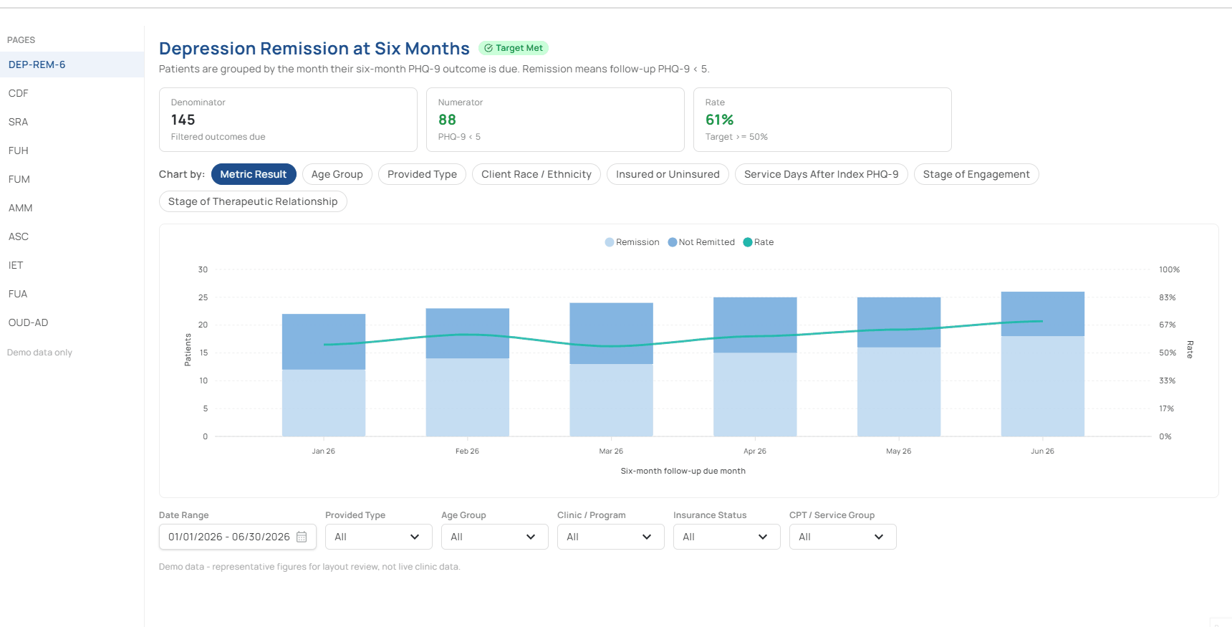
LIVE FILTERING
We Build Reports
That Slice Every
Way You Need.
We deliver every report filterable by age, race, and insurance
We build the breakdowns in — filter on screen, export when needed
Whatever cut an auditor asks for, it's already in the report
02

Slide 4
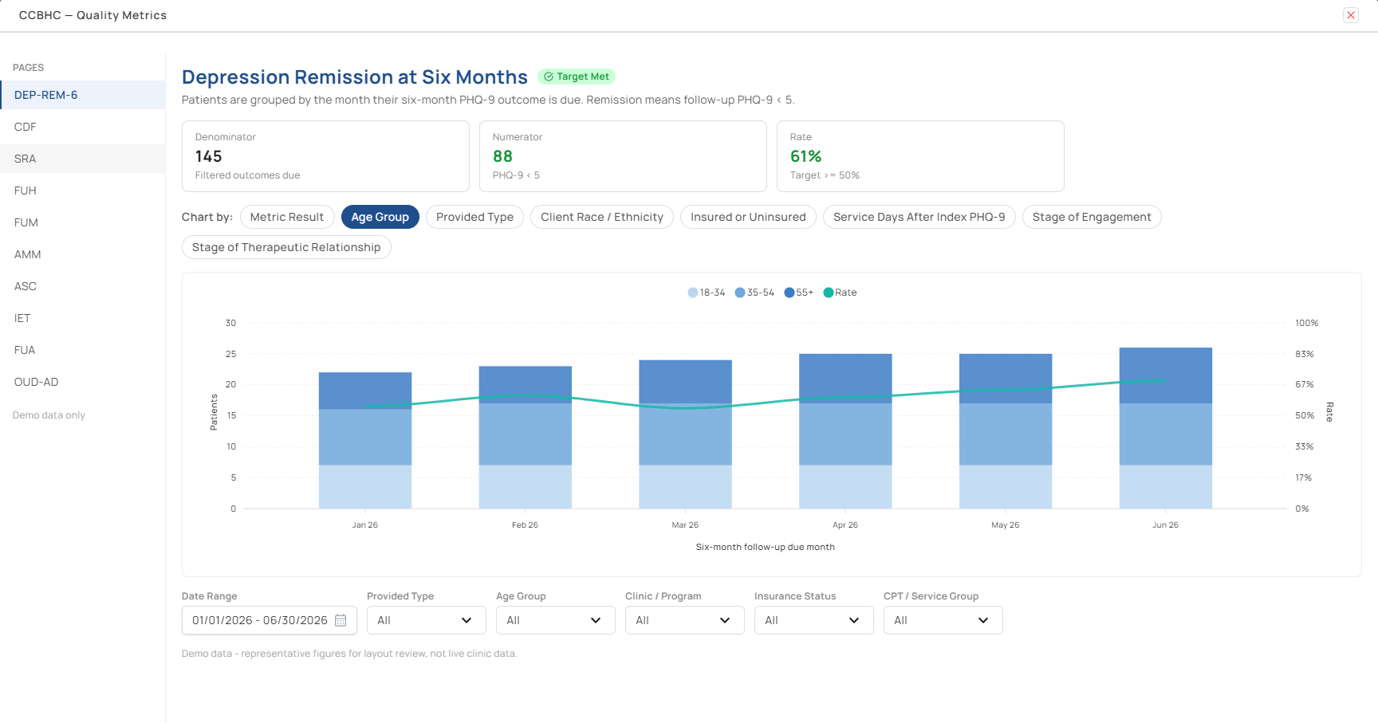
QUALITY MEASURES
Quality Measures:
Federal CCBHC
Measure Tracking.
All CMS-required measures in one place — no chasing separate reports
Pass-or-miss against target shown automatically for every measure
Adult and child results split out for you, always up to date
03

Slide 5
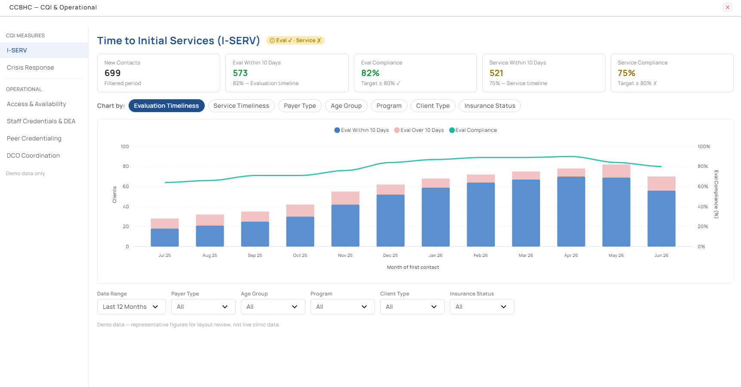


TIME TO SERVICE
I-SERV: Time to
Initial Services
Tracking.
Evaluation timeliness tracked automatically against the 10-day standard
Service timeliness tracked in the same report — the gap surfaces itself
Crisis response always current on its own benchmark
04

Slide 6
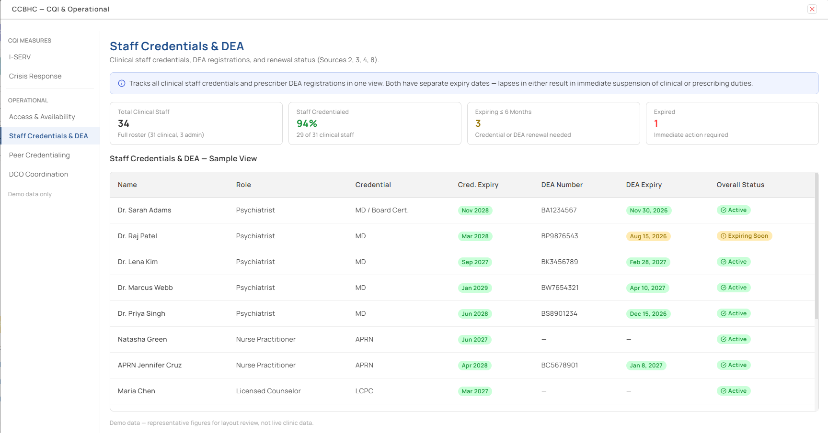
CREDENTIALS & DEA
Staff Credentials
& DEA Expiry
Tracking.
Every credential and DEA expiry tracked in one place, per staff member
Renewal alerts surface automatically before anything lapses
Color-coded status — Red expired, Amber renewing soon, Green safe
05

Slide 7
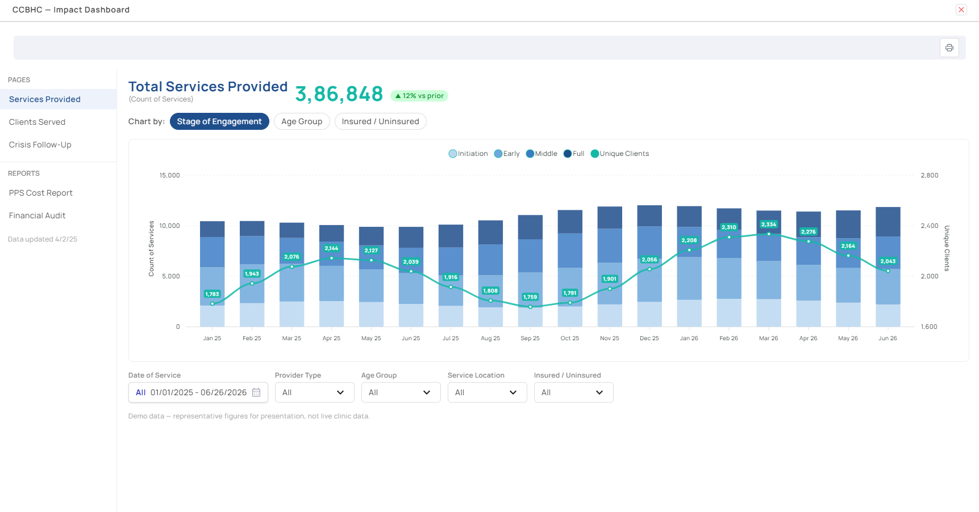
SERVICES & CLIENTS
Services Provided:
Services & Client
Tracking.
Total service volume tracked automatically from day one of CCBHC adoption
Service trends tracked month over month, always up to date
Unique clients, new clients, and crisis follow-up always in one place
06

Slide 8
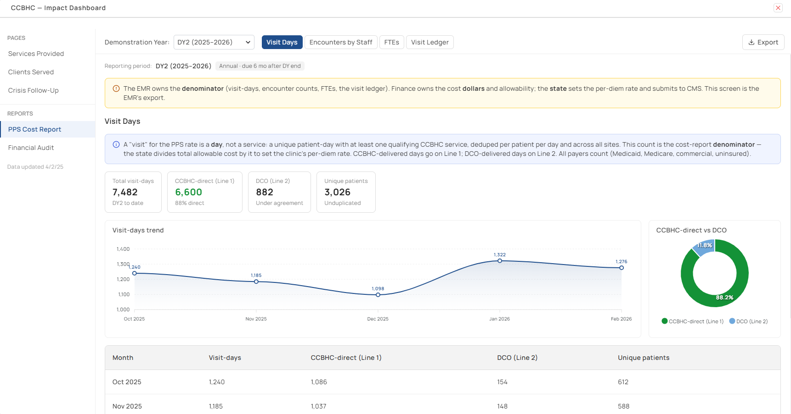
PPS COST REPORT
PPS Cost Report:
Annual CMS Cost
Filing.
Visit-days pulled automatically from patient encounter data
CCBHC-direct vs DCO visits split for you — no manual sorting
Encounters and FTEs calculated in the report, not in spreadsheets
07

Slide 9
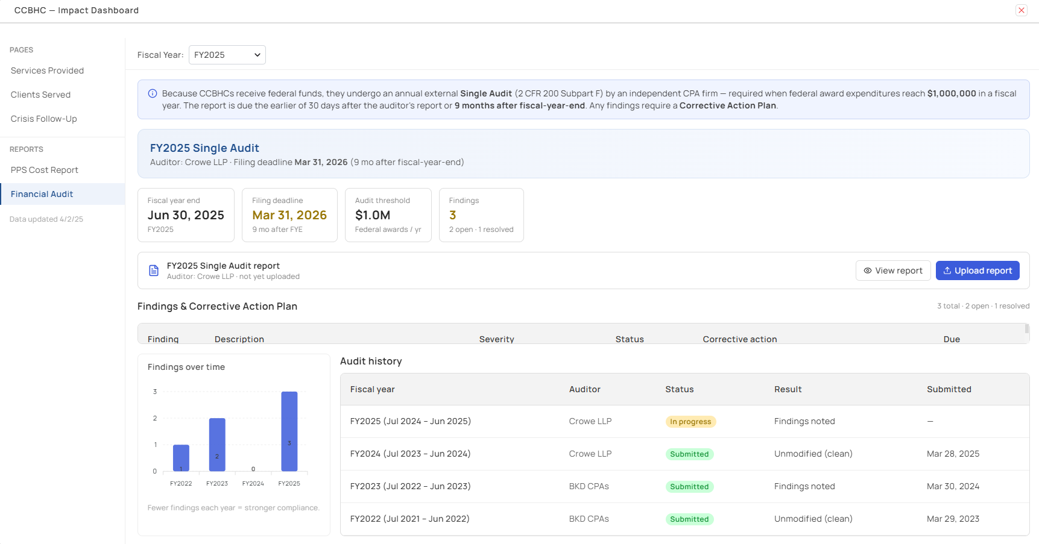

FINANCIAL AUDIT
Financial Audit:
Findings & CAP
Tracking.
Every finding tracked with its corrective action plan and due date in one place
Material weaknesses flagged in red automatically — never missed
Full audit history kept current, year over year
08

Slide 10
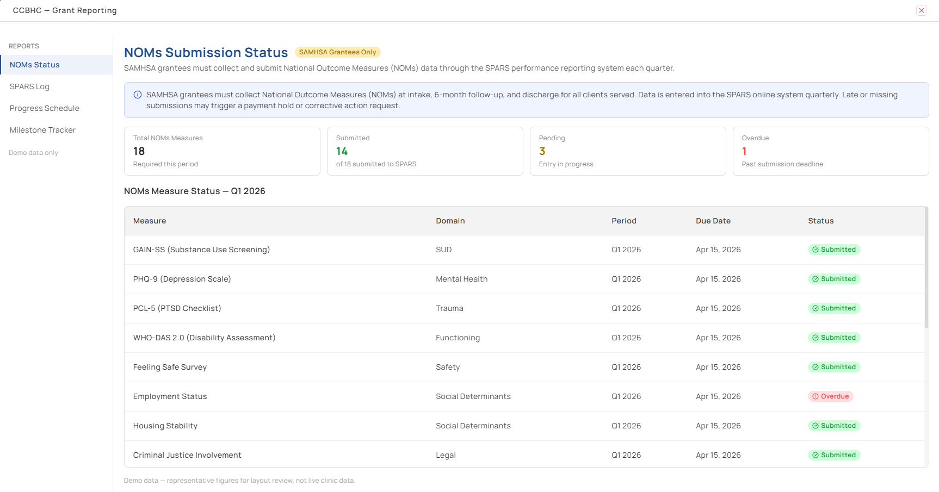
GRANT REPORTING
NOMs: SAMHSA
Grant Submission
Tracking.
PHQ-9, GAIN-SS, PCL-5, WHO-DAS and all required measures tracked in one place
Overdue measures flagged automatically before grant renewal is at risk
Full SPARS submission log with acceptance history, always current
09

Slide 11
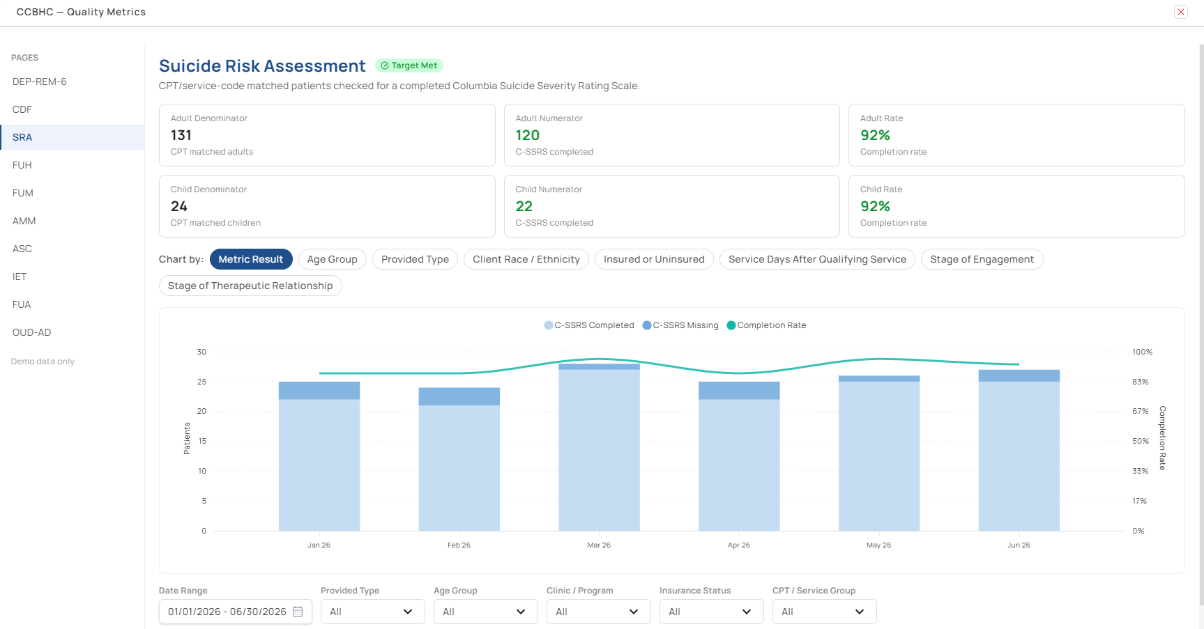
AUDIT-READY
Everything a CCBHC Auditor
Will Ask For —
Already Answered.
No scrambling. No manual exports. No missed deadlines.
Quality measures to grant submissions — every report in one platform
Credentials, DCO partnerships, board composition — all tracked, all current
CurerTech keeps every report audit-ready, every single day
10

